Slide 1
Happy Healthy Tummies
Jason Mapou
John McGuire
Prashanth Mijar
Mukti Pancholi

Slide 2
Introduction/Concept
Happy Healthy Tummies app built to find restaurants based on location, food choice and nutrition information unique to each user.
An App built for health conscience people who lead busy lives who may not have time always to make a meal on the go so they can search their food item they want to get from a restaurant near a location the user specifies plus get the nutritional information back for that food item based on the personal nutritional criteria the user has set up.
This app is for working adults, traveling out of town individuals, and simply health conscience individuals who need instant information where to go to get a meal that fits their nutritional specifications.

Slide 3
The Process
First time user
Create profile and provide basic nutritional inputs
Existing user
Simply login
All user information saved in Firebase
Once login complete user enters Search and Results page.
User chooses to enter one of three location methods
Current Location
Address
Zipcode
Login
Preferences
Storage database
Search Box
Utilizing Location API and Nutritional API
Mapping/merging two API calls
Results Table
Display
Food item, restaurant name, location, distance, navigate.

Slide 4
Further Breakdown of Process
First time user
Create profile and provide basic nutritional inputs
Existing user
Simply login
All user information saved in Firebase
Once login complete user enters Search and Results page.
User chooses to enter one of three location methods
Current Location
Address
Zipcode
Login Page – Two Options
Existing User enters username/password - submit
New User registers username/password – submit
Preferences Page
New user enters their nutritional criteria
Existing user can update their nutritional information.
All fields must be entered
Error Alert if all entry fields not completed.
Storage database - Firebase
User Login and Preferences are stored in Firebase

Slide 5
Further Breakdown of Process - continued
First time user
Create profile and provide basic nutritional inputs
Existing user
Simply login
All user information saved in Firebase
Once login complete user enters Search and Results page.
User chooses to enter one of three location methods
Current Location
Address
Zipcode
Search Page
Search Box – includes the following:
Utilizing Location API and Nutritional API (Mapping/merging/nesting two API’s)
Enter Food Item
Submit button
Error Alert displays if fields are not correctly entered
Preferences Box
Nutritional specifications already in Firebase will be displayed in a separate box.
Results Table
Displays: food item, restaurant name, location, distance, navigate (map)
User has option to select restaurant and be navigated to a map (on a different screen) if they choose
Map will display user location to chosen restaurant. Point A to Point B

Slide 6
Tech Talk
Location API:
If user allows permission to use Current Location – Google Maps Geo Coder API
If user enters address or zip – OpenCageData API
Both return lat/long
Nutritionix Location API
Use lat/long to search for restaurants in the area
Returns all restaurants, their ID’s and location (lat/long and address)
Nutritionix Instant Search API
Search for food user entered and filters by restaurant ID’s and also Users preferences preferences
Returns list of foods that match above criteria, nutritional information and restaurant name.
Display Map
Use lat/long of restaurant and user’s lat/long to display map with directions or restaurants address.

Slide 7
Demo Time

Slide 8
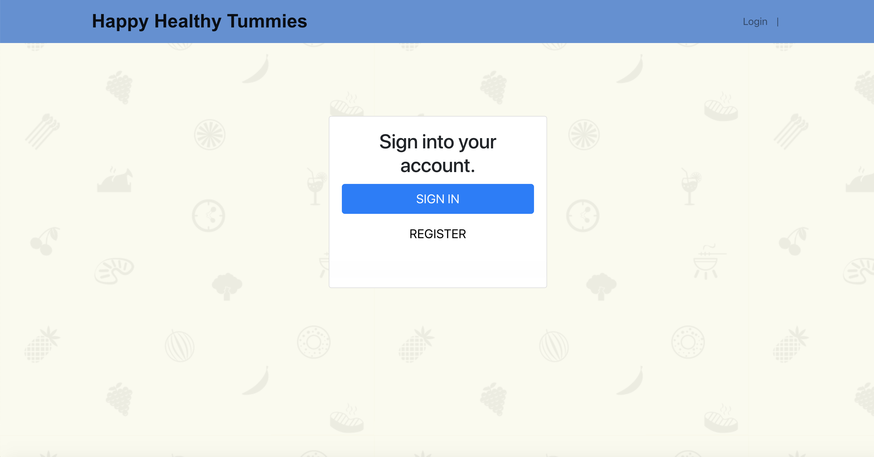
Demo Time – Login Page

Slide 9
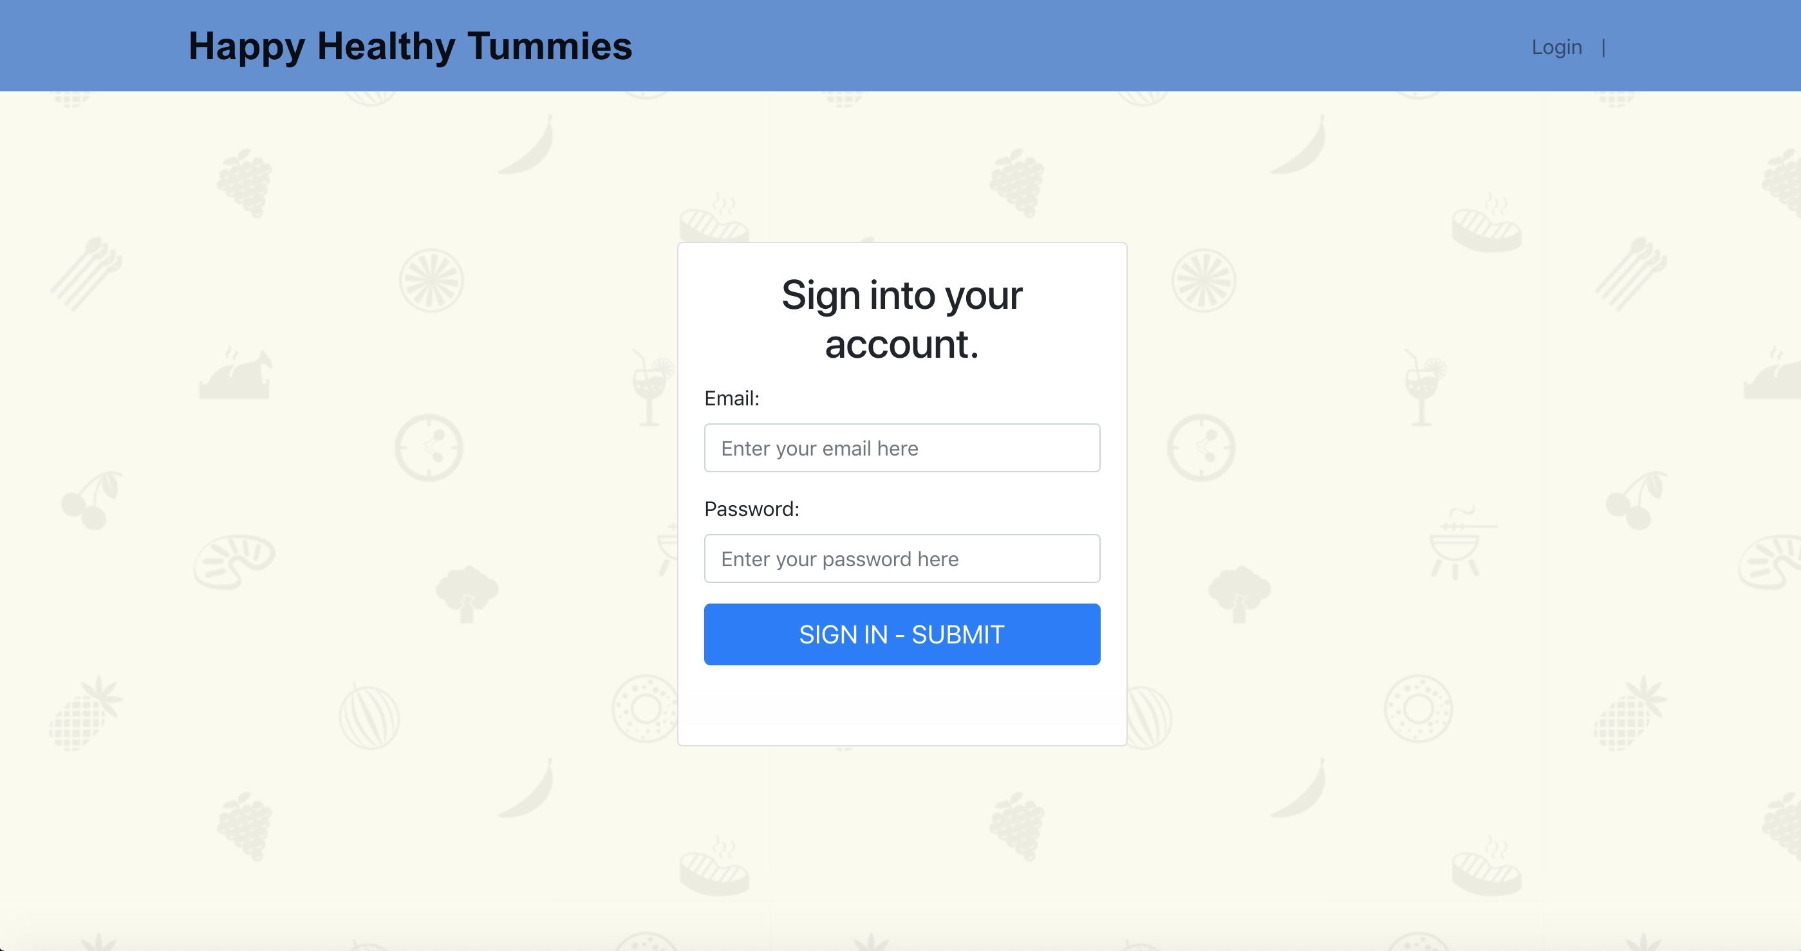
Demo Time – Login

Slide 10
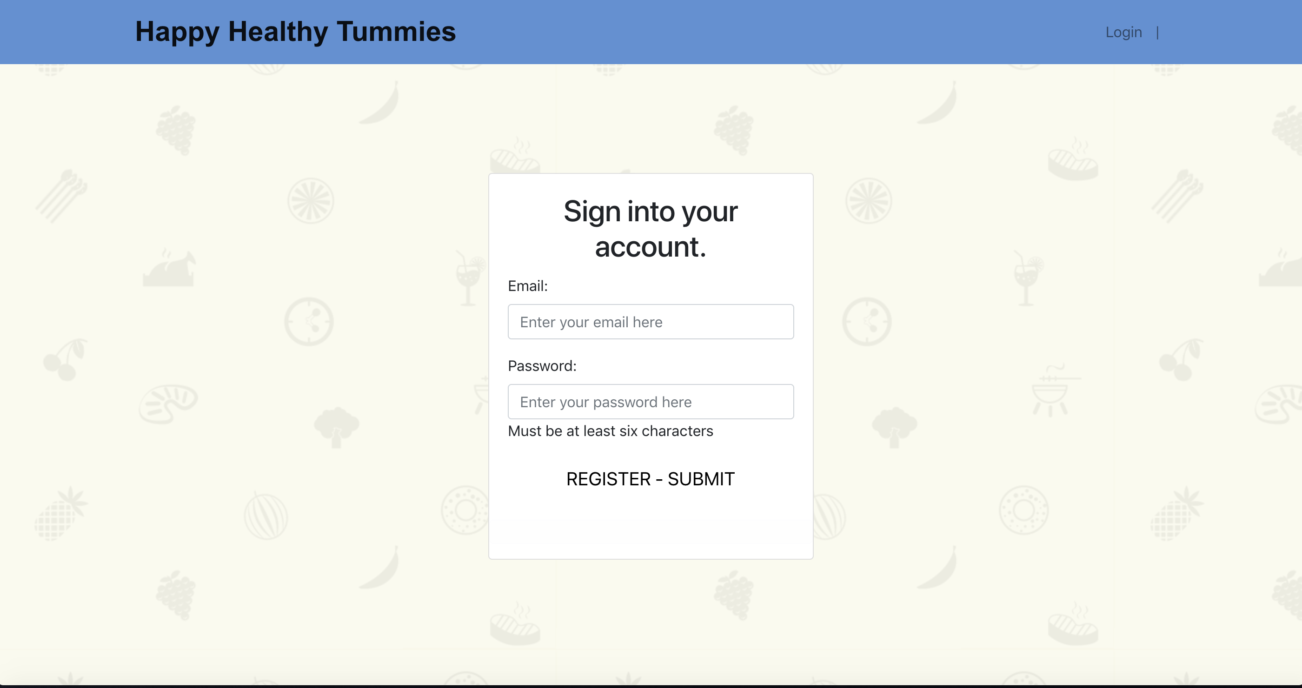
Demo Time – Login New User

Slide 11
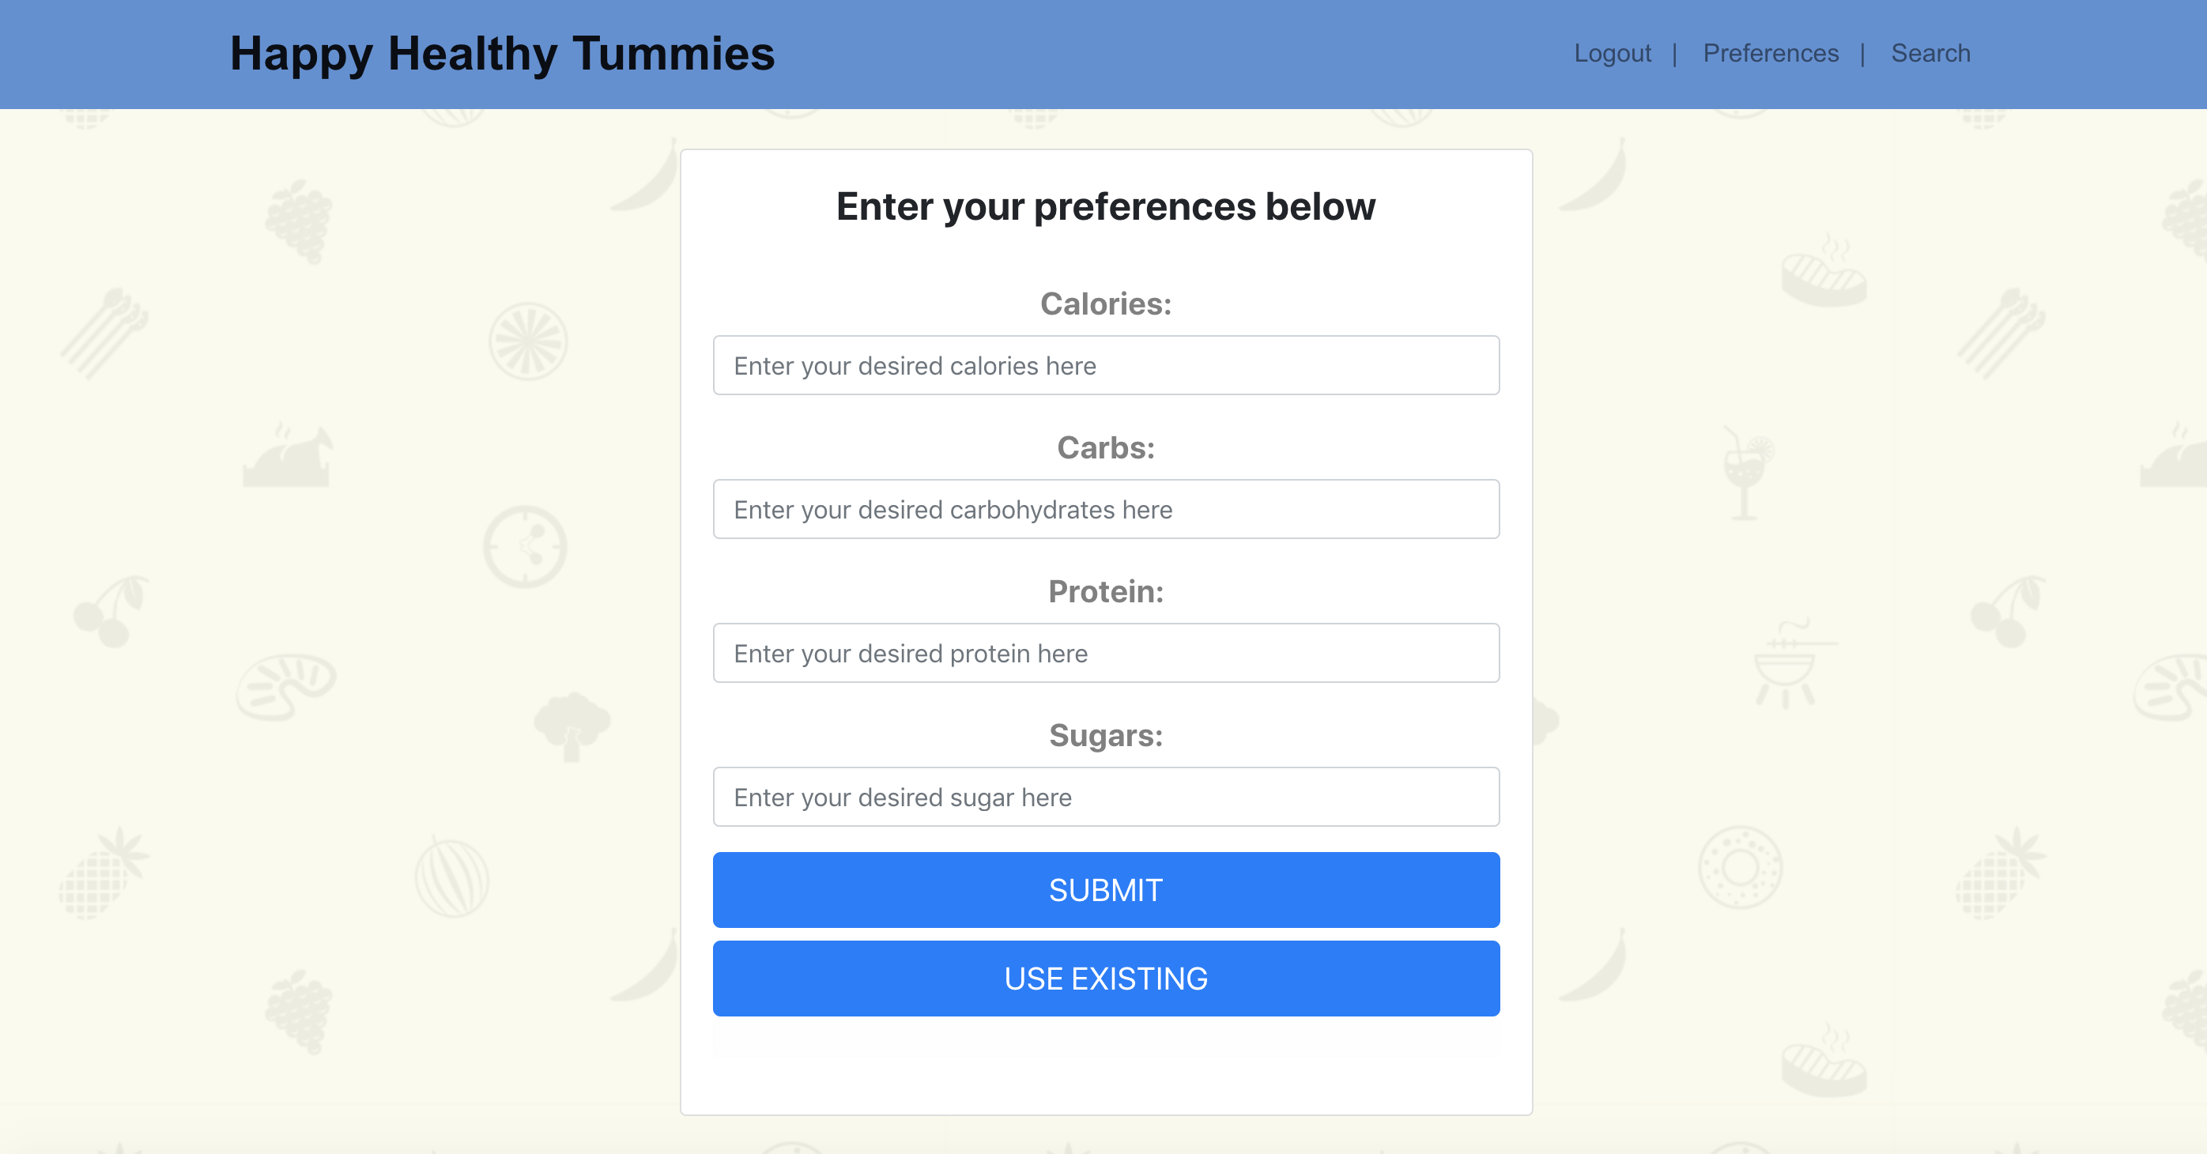
Demo Time – Preferences Page

Slide 12
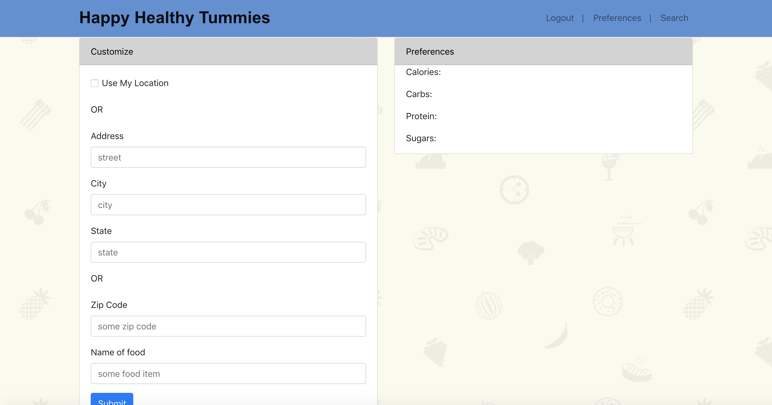
Demo Time – Search Page

Slide 13
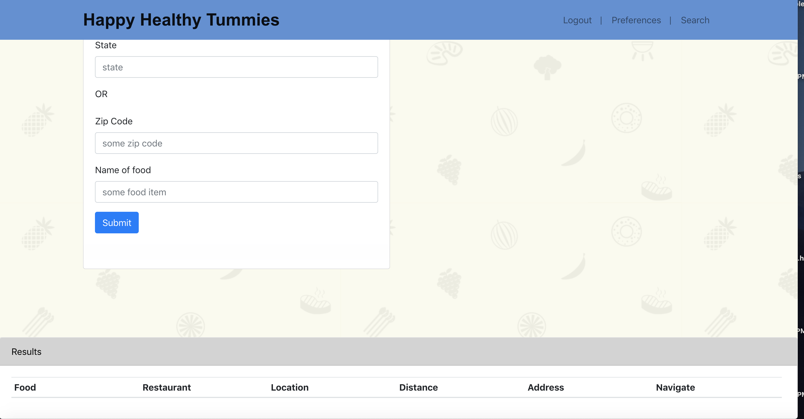
Demo Time – Search Page

Slide 14
Future
Option to add more nutritional information in Preferences.
Improve on navigation capabilities

